Slide 1
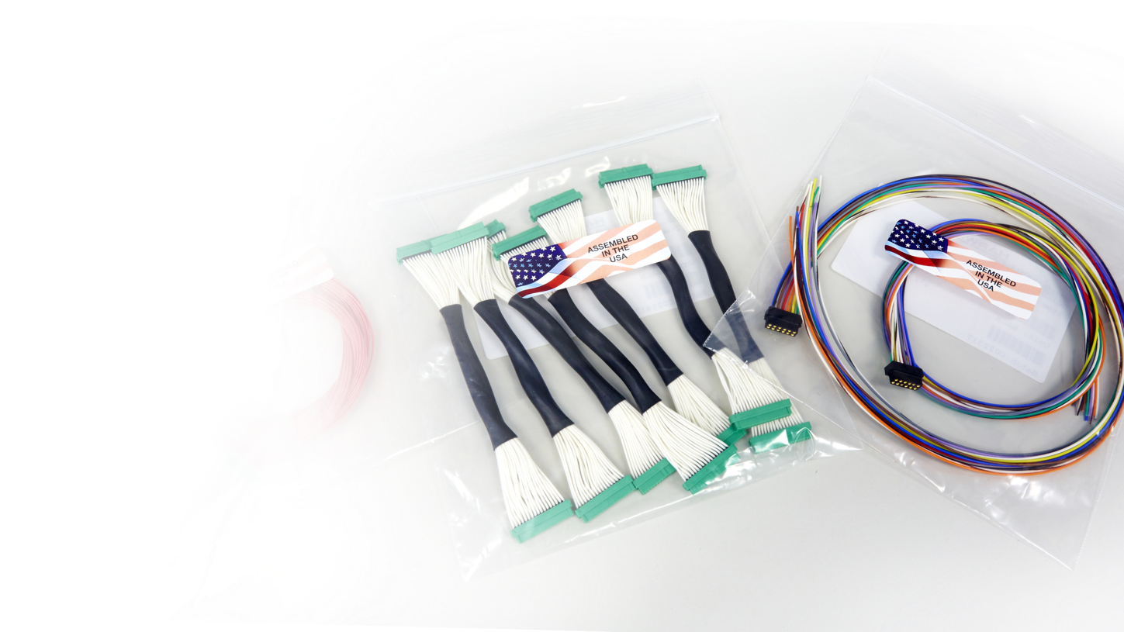
CABLE PRODUCTS

Slide 2
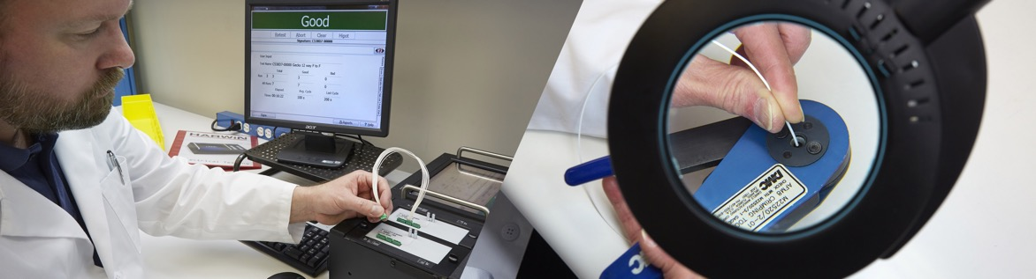
Introduction
Making full cable assemblies from start to finish using the individual contacts and housings can be tricky, time consuming and expensive. Here at Harwin we are fully equipped to help you with this process – or handle it for you completely!
This training module will cover all the different services that Harwin can offer to complete your cable assembly.

Slide 3
Contents
Pre-cabled contacts
Off-the-shelf cable assemblies
Backpotting
Backshells, hoods
Shielding & protection
Twisted Pairs
Labelling, cable management
Cable Generator
Ribbon cable assemblies
Cable assemblies for PCB connectors
Customized cable assemblies
How we can help
We have a lot of options to incorporate into your cable assemblies. To help you navigate through this module, click on the item above to jump to the featured service.

Slide 4
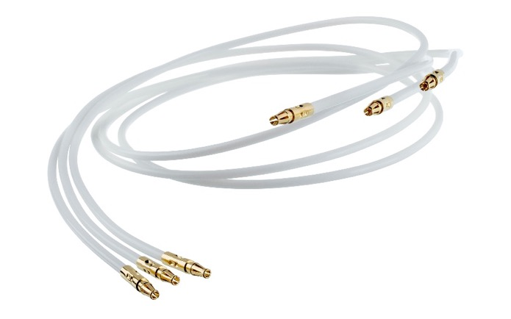
Pre-cabled contacts
The most basic level of ready-made cable assemblies, these are simply the individual contacts fitted with an appropriate wire. The assembly may be single or double ended, and come in a choice of colour and length. You will need to purchase the connector housings and insertion tooling separately. It does not eliminate all your processes, but does eliminate the hardest operation and most expensive tooling – crimping.
We stock some options at pre-set lengths and colours for you to purchase off-the-shelf – check the website or contact us for help.

Slide 5
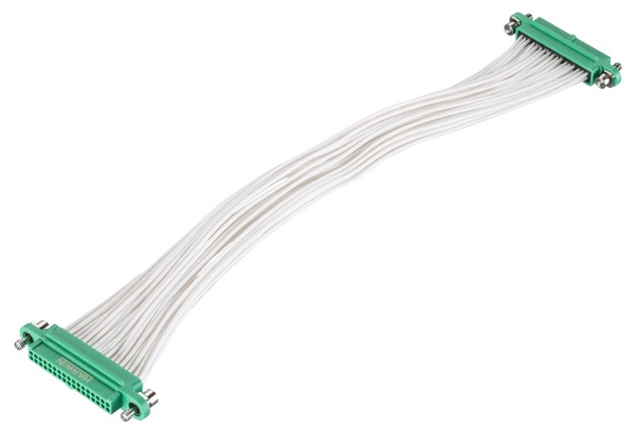
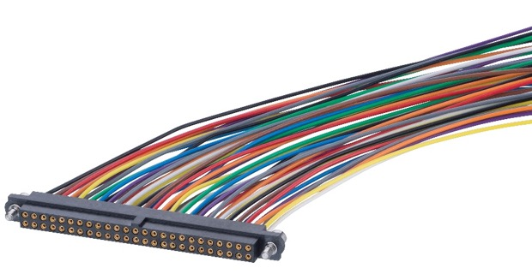
Ready-made basic cable assemblies
We have a wide selection of ready-made cable assemblies, and these options are being added to regularly. Choices include single and double ended, in lengths of 150/300/450mm (6, 12 and 18”). Typically the wire color will be white for double ended, multi-color for single ended (although there are some exceptions).
These items can be found on the website under their applicable product family, choose “Cable Assemblies” in the second layer of options.

Slide 6
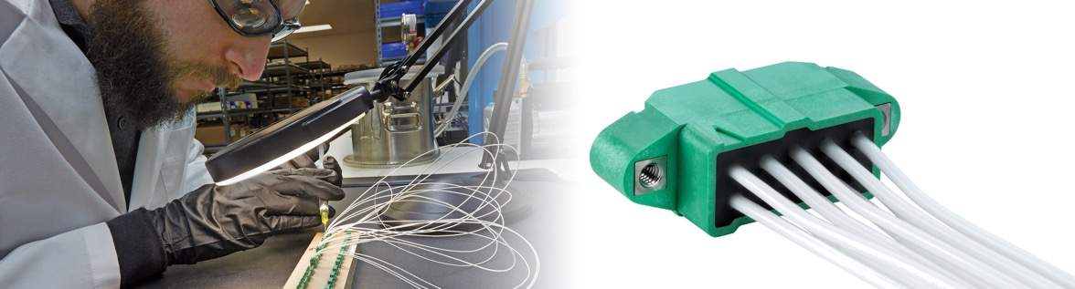
Backpotting
All connectors with extended rear walls will also be backpotted as standard. This assists with strain relief – read more on our popular “What is backpotting” article.
Backpotting walls are available on our High-Reliability ranges of Gecko and M300, and selected Extended Wall Datamate-J-Tek connectors.
Backpotting can also be accommodated on certain products without walls by adding temporary dams – ask our Experts for assistance.

Slide 7
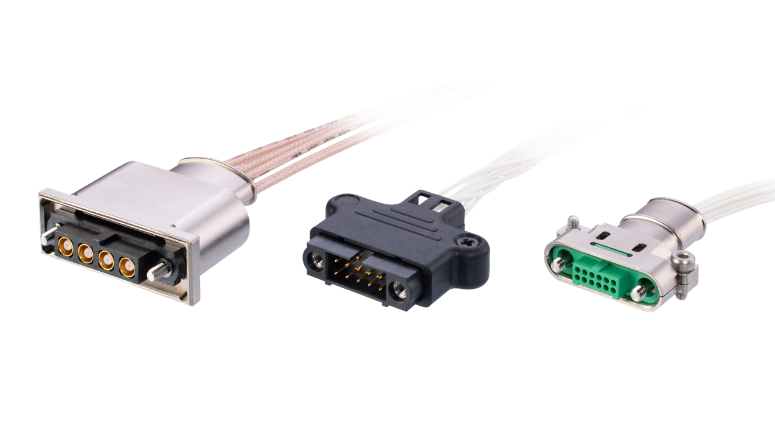
Backshells or hoods
Some connectors also have the option of hoods or backshells, which can be fitted for added strain relief or mechanical protection. Available with:
The Datamate and Gecko metal backshells can also be applied to Datamate Mix-Tek and selected Gecko-MT cable assemblies respectively.
Gecko-SL – metal backshells (can be fitted after cable assembly)
Datamate J-Tek – kits with plastic hoods
Datamate J-Tek – metal backshells (must be fitted before assembly)
Datamate L-Tek – plastic hoods for double row female cable connectors

Slide 8
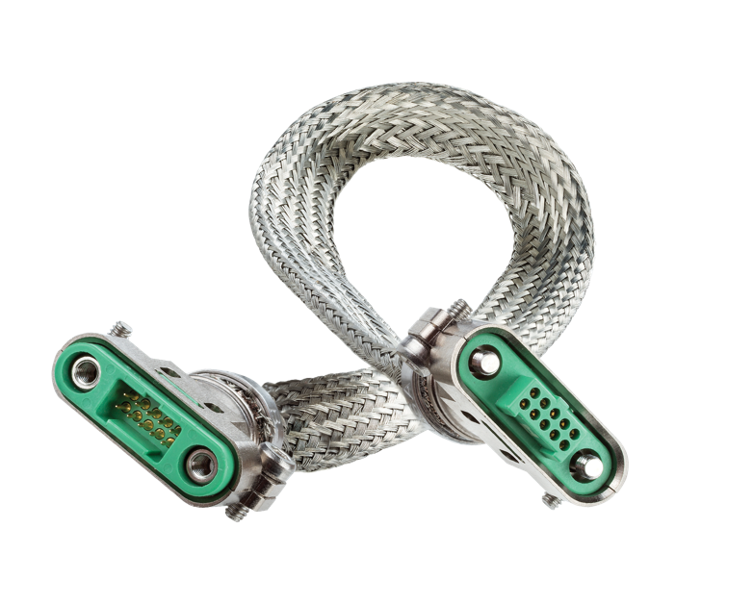
Full Cable Assembly Shielding and Protection
In combination with the metal backshells, adding metal braiding along the length of the cable assembly completely shields the whole product. We can supply a fully finished cable assembly with the shielding braid fixed in place with Band-It ties. For the Gecko-SL product range, we have even developed a standard part numbering system for these options.
Alternatively, plastic braiding or heatshrink provides a level of protection to the cable bundle – ask for further information on these options.

Slide 9
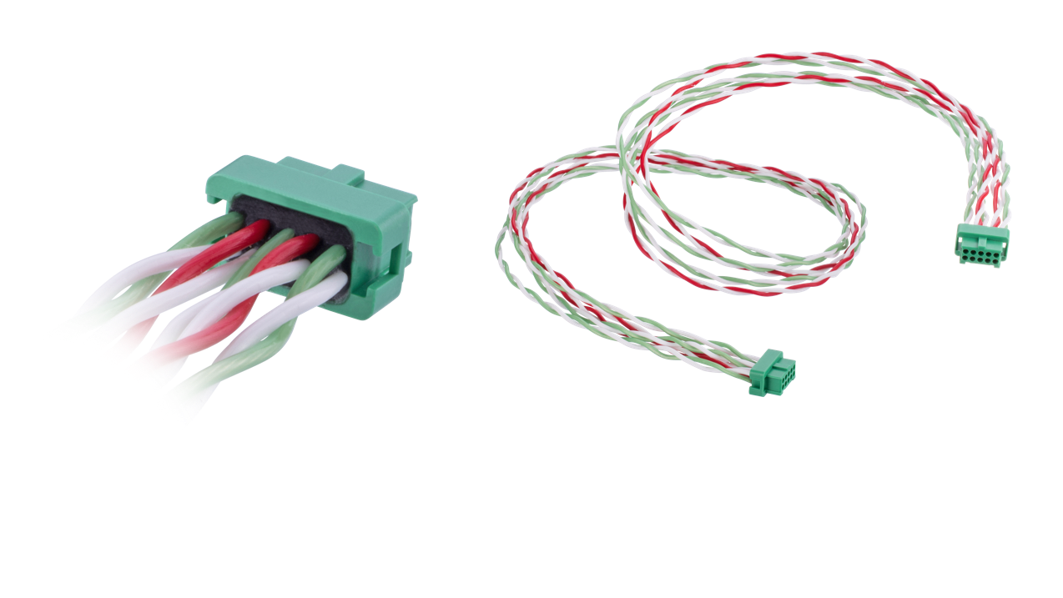
Twisted Pairs
This cable style is very popular – for some customers, it is now the default requirement. Harwin uses two cable twist pitches (seen in the image as red/white and green/white), and alternates these two across the connector. This helps combat crosstalk across adjacent pairs of wires. We have developed a standard part numbering system for these options within the Gecko Latch and Gecko-SL product ranges.
For maximum EMI defense, Gecko-SL includes a range incorporating both twisted and shielded cables, made on demand.

Slide 10
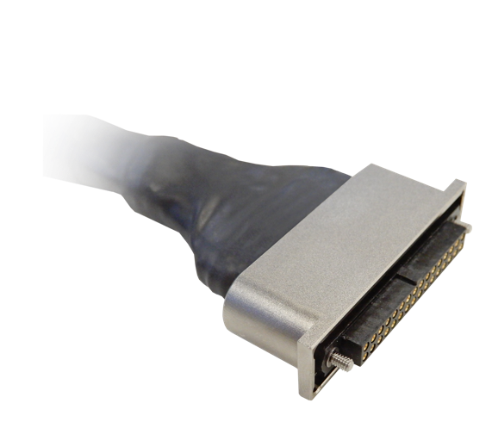
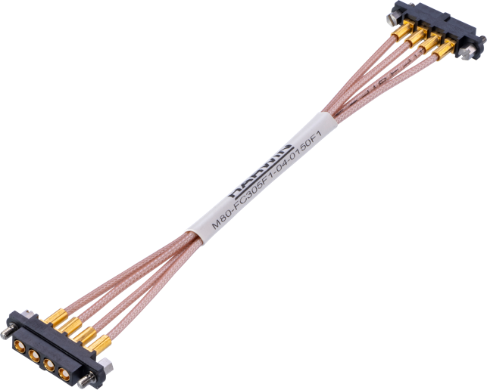
Labelling and Cable Management
To finish off your cable assembly, Harwin can also offer custom labelling, even incorporating a logo (space allowing).
Managing longer cable bundles can be helped with additional cable ties or heatshrink to maintain a tidy wiring loom.

Slide 11
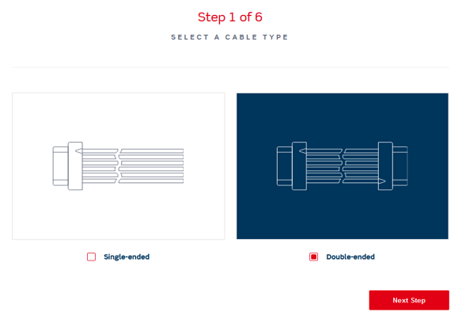
Cable Generator
Harwin’s Cable Generator is designed to help you through the process of specifying a variant cable assembly, step-by-step. This easy-to-use builder will help you define cable styles / sizes and the Harwin connector you need, and send your information directly to us to arrange a quotation.
Already included are many variations of Gecko, Datamate and M300 connectors, with power and coax as well as signal. Further options often in development, so check back later for future additions. If you can’t specify the cable assembly you need, just talk to our Experts.

Slide 12
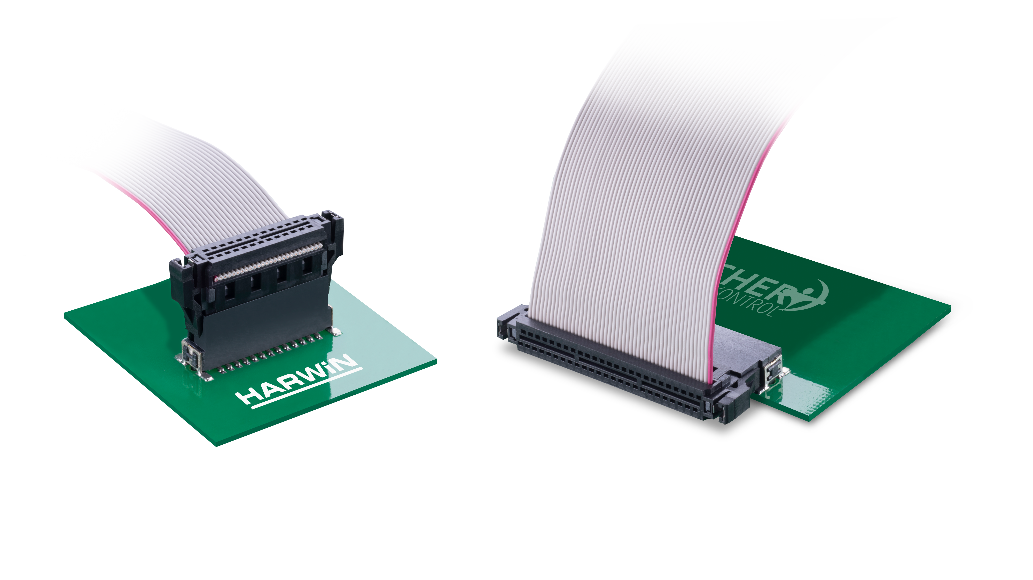
Ribbon Cable Assemblies – IDC Connectors
Kontrol and Archer ranges both include ready-made cable assemblies, constructed with IDC connectors and ribbon cable. The cable is UL rated with 30 AWG cores. These assemblies are available off-the shelf in 150mm, and some selections are also available from stock in 300mm. Other cable lengths can be supplied on request.

Slide 13
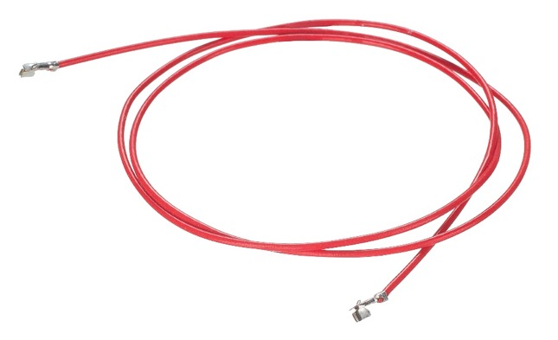
Cable Assemblies for PCB Connectors
We can also help with cabling on our PCB Connector ranges. As crimping the smaller contacts in the M30 (1.25mm pitch) and M40 (1mm pitch) ranges can be awkward and tricky, we offer pre-cabled contacts on red wire in 150 and 300mm lengths. These are easy to assemble into their applicable housings, and require no tooling for this process.
For M20 (2.54mm pitch) and M22 (2mm pitch), we can help with your cable assembly made-to-order.

Slide 14
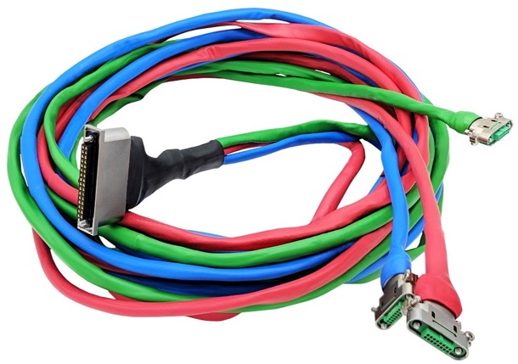
Customized cable assemblies
We’re happy to help your custom cable connection become a reality.
The above design incorporated many of the different options we can offer - Datamate J-Tek with metal backshells connecting to three Gecko-SL with metal backshells. Under the multi-color heatshrink are fully braided cable bundles for a completely shielded wiring harness.

Slide 15
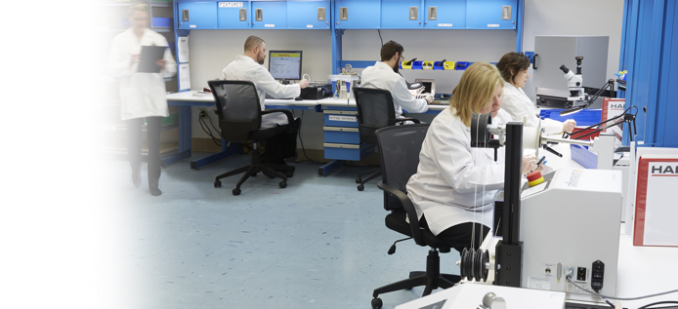
How can we help?
Build to your Datasheet
Prototype quantities
100% Inspect and Test
Trained to IPC-620
Advice from Experts
We want to help your cable assembly using Harwin connectors to become a reality. Contact us today with your requirements, and we’ll do our best to help you through the process.

Slide 16
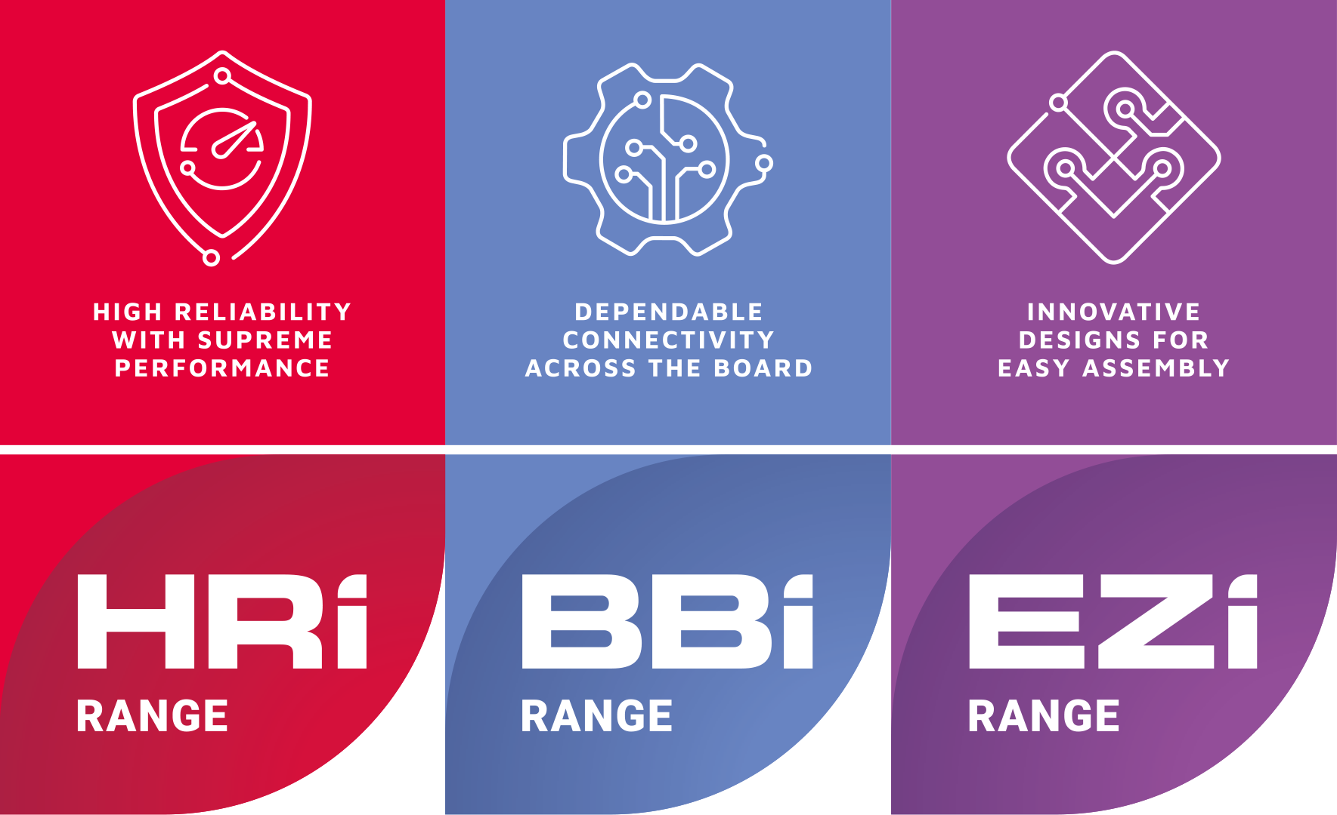
Learn more about
our other ranges
Find out more about our full range
of inter-connection solutions at
www.harwin.com

Slide 17
GET HELP FROM A
HARWIN EXPERT
Our experts are specialists in their field with many
years of experience in their respective roles and
industries.
Find an expert that can help you with
your enquiry.
Click Here >>
CAD Models and Evaluation Samples also
available at www.harwin.com

Slide 18
Contact Us

