Slide 2
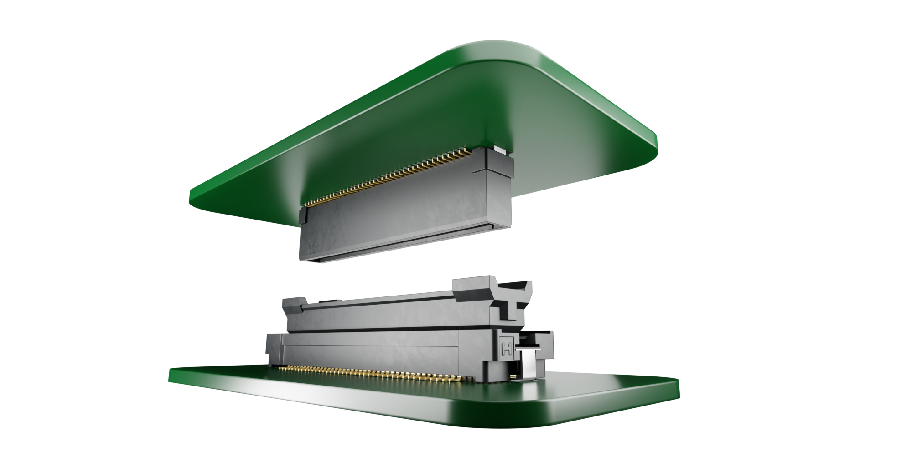
Smaller connections for the industry
Industrial and automation systems require more features, but control modules must occupy less space. Hand-held products for both Consumer and Business must be compact but highly capable. These needs result in stacked boards with multiple micro-pitch connections.
Flecto Floating Connectors allow for multiple connectors between the same two PCBs, without the issue of placement accuracy.

Slide 3
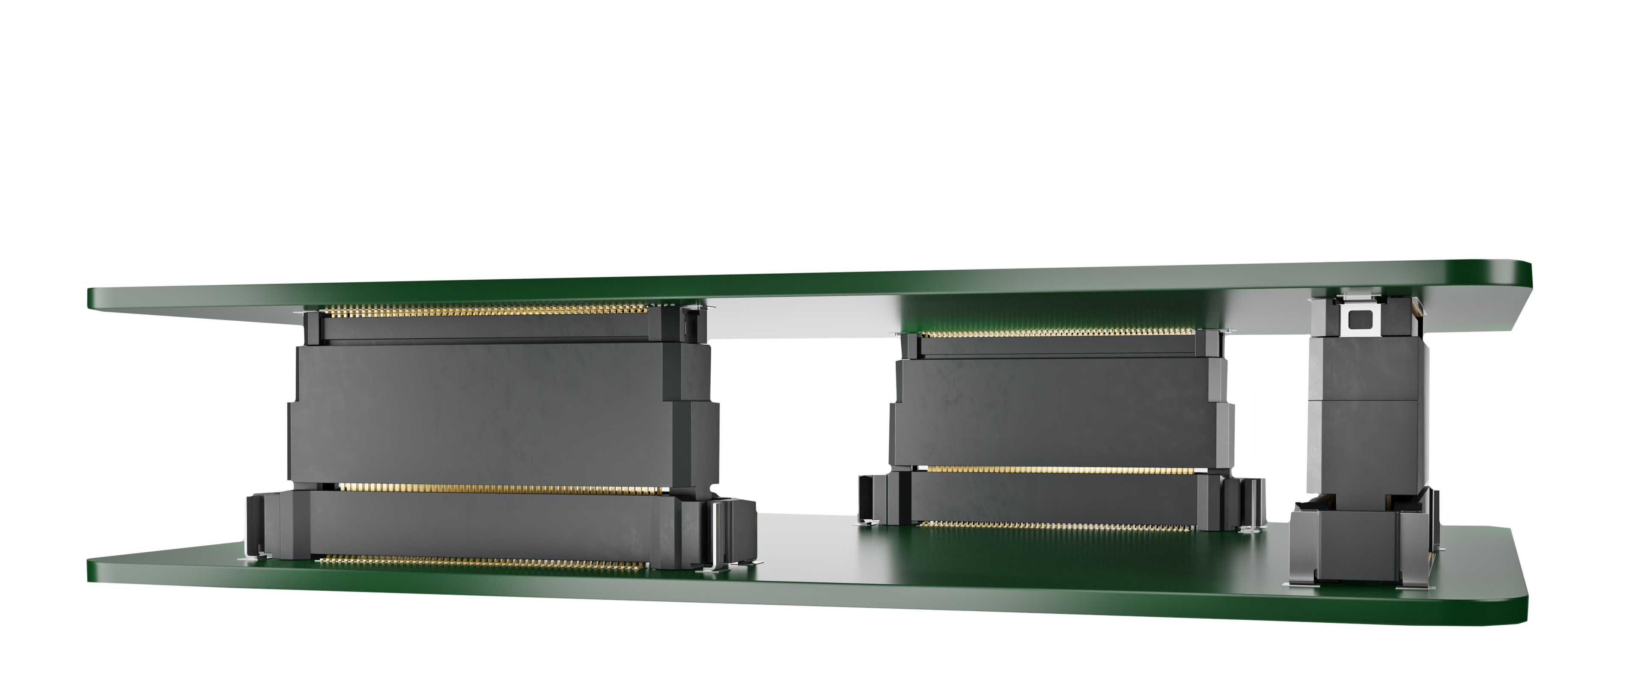
FLOATING BOARD-TO-BOARD CONNECTIONS
When you have two connectors mating the same two PCBs, the tolerance of the product location (whether from PCB manufacture, paste location, pick and place accuracy or a combination of these) can mean that one or both connectors will encounter additional side-loading. This has the risk of long-term stress and damage on the connectors.
Flecto connectors eliminate this, with the male mating contact areas able to “float” within the housing.

Slide 4
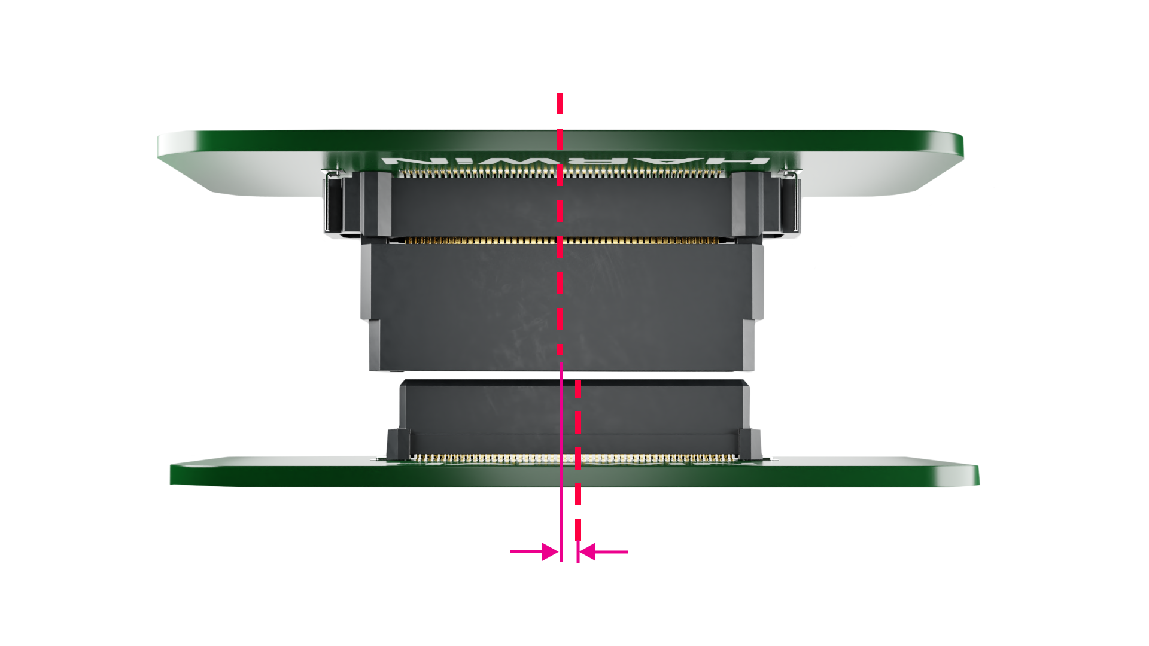
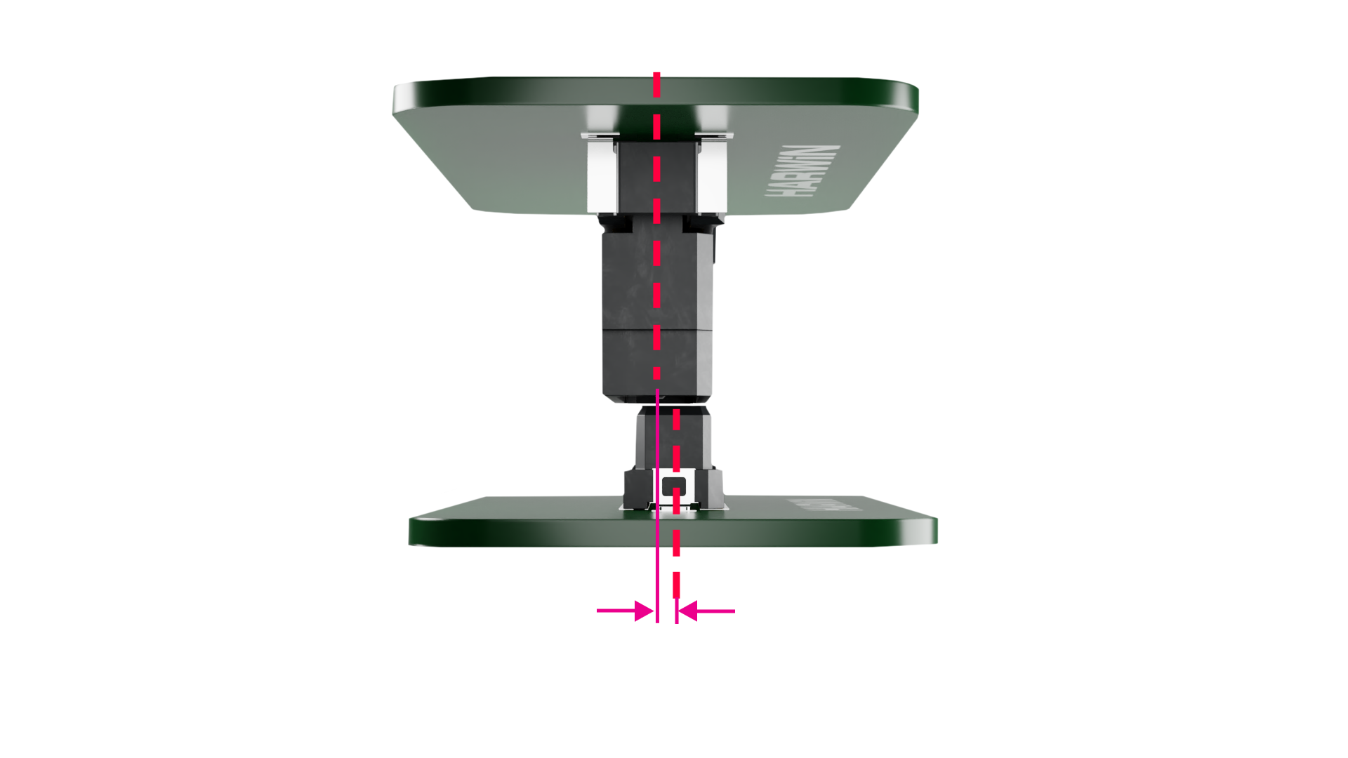
Features – Tolerance to misalignment
The connectors can be offset before mating by up to 0.5mm (up to 0.8mm for some ranges). This eliminates connection issues caused by placement tolerances and solder misalignment problems.
Any stresses are eased by the movement of the male connector, and the mating process during equipment assembly is easier and faster.

Slide 5
Features – Tolerance to misalignment
X
Z
Y
The connectors can also be offset when mated. The “floating” section in the male connector enables up to ±0.5mm of movement in the X, Y and Z axes (up to ±0.8mm in X and Y for some ranges). This allows for multiple connectors mating between two PCBs, as all placement tolerances and solder misalignment problems are absorbed within the floating movement.

Slide 6
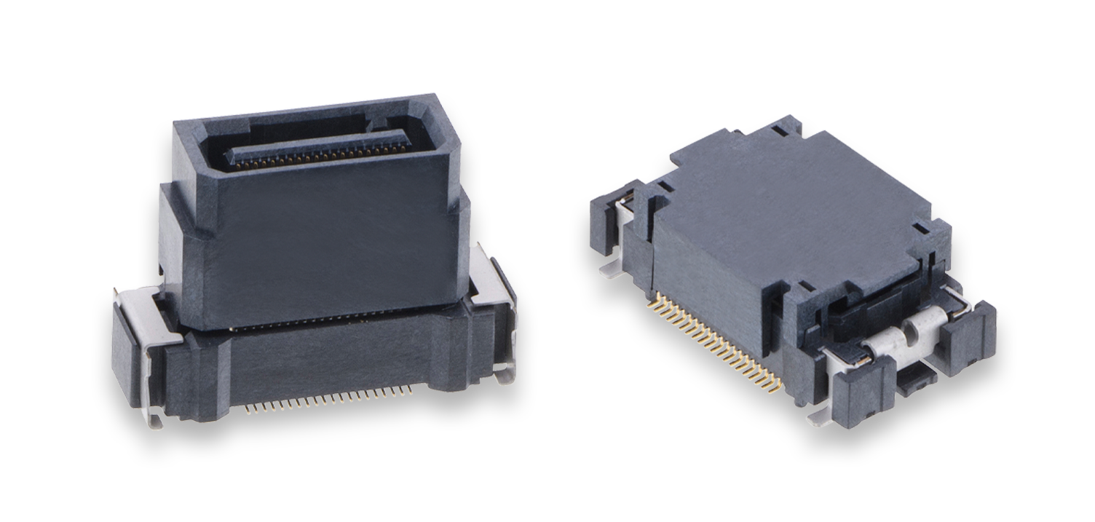
Features – UP TO 12Gbit/s Data Rate
By using insertion loss and Near End Cross Talk (NEXT) testing methods, a conservative estimate of the data rate for mated connectors is established at:
4GHz, 8Gb/s for 0.50mm (.0197”) pitch
6GHz, 12Gb/s for 0.635mm (.025”) pitch
2.5GHz, 5Gb/s for 0.8mm (.0315”) pitch
Further information and test result graphs can be found in the HT090 Test Report Summary.

Slide 7
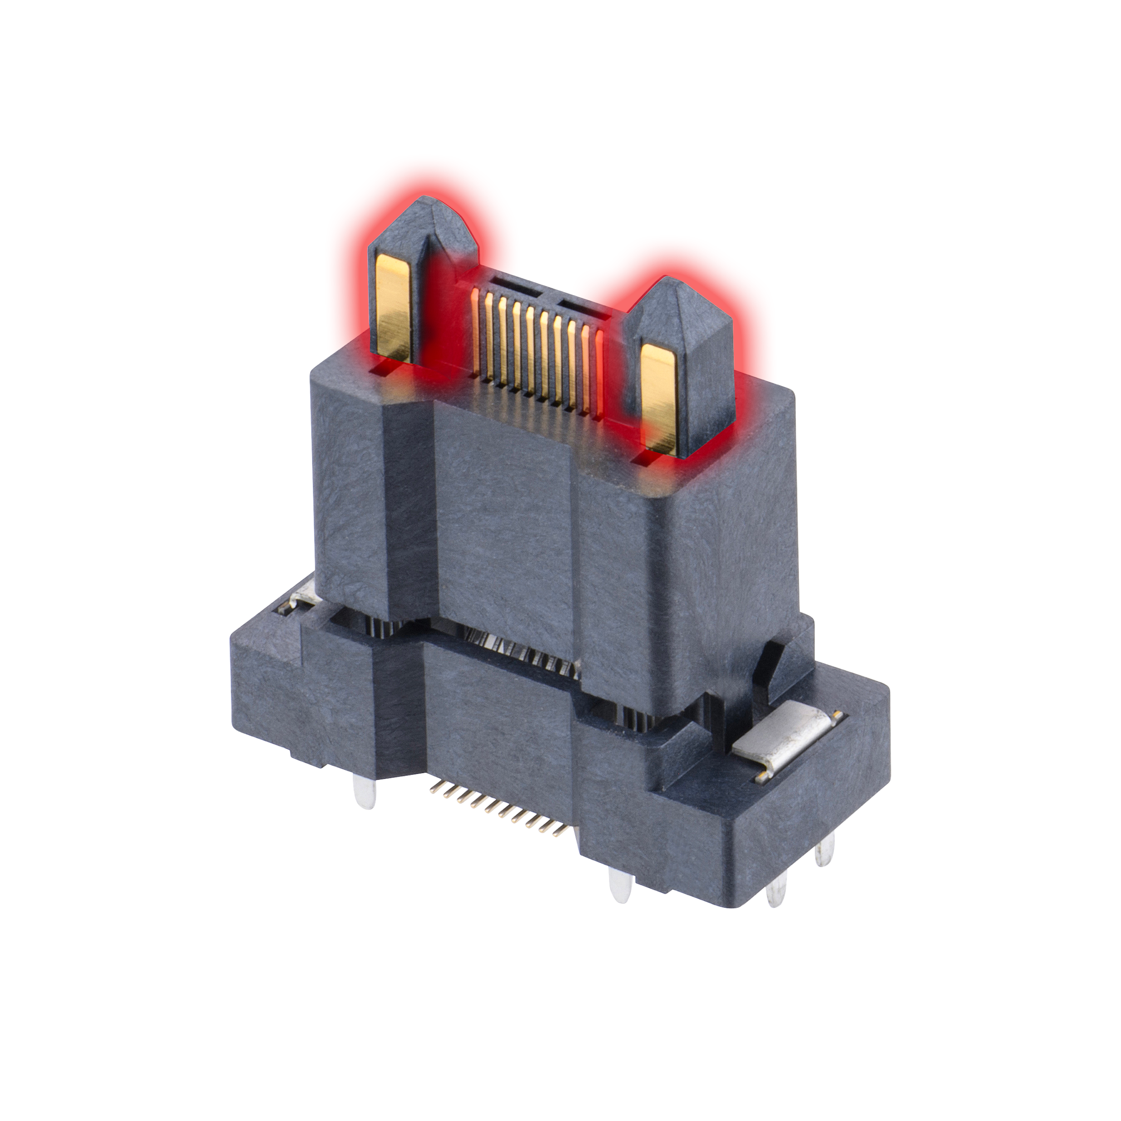
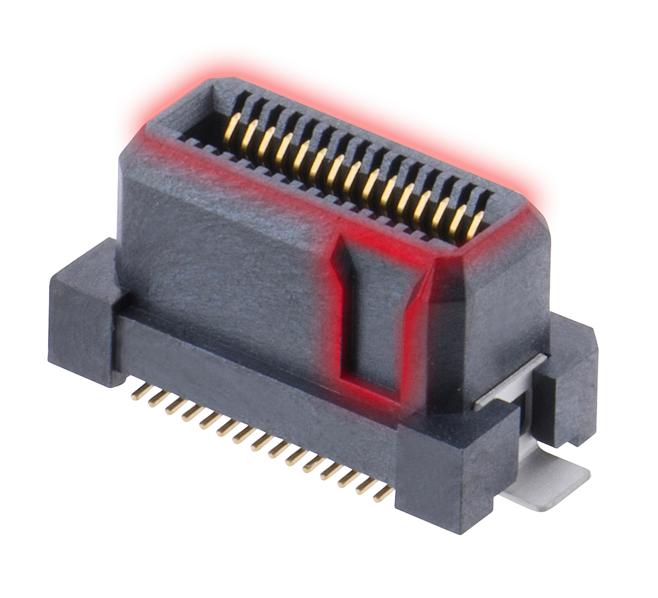
Features – Shrouding and Polarization
Some connectors in this range feature shrouded contacts, to prevent accidental damage to the miniature contacts. Some designs include polarization within the shroud to ensure assembly in only one direction. Check the individual product pages to confirm shrouding and polarization.
When power pins are included, they are located on large posts on the male side. This assists with blind mating, where visibility during the mating action is obscured or absent.

Slide 8
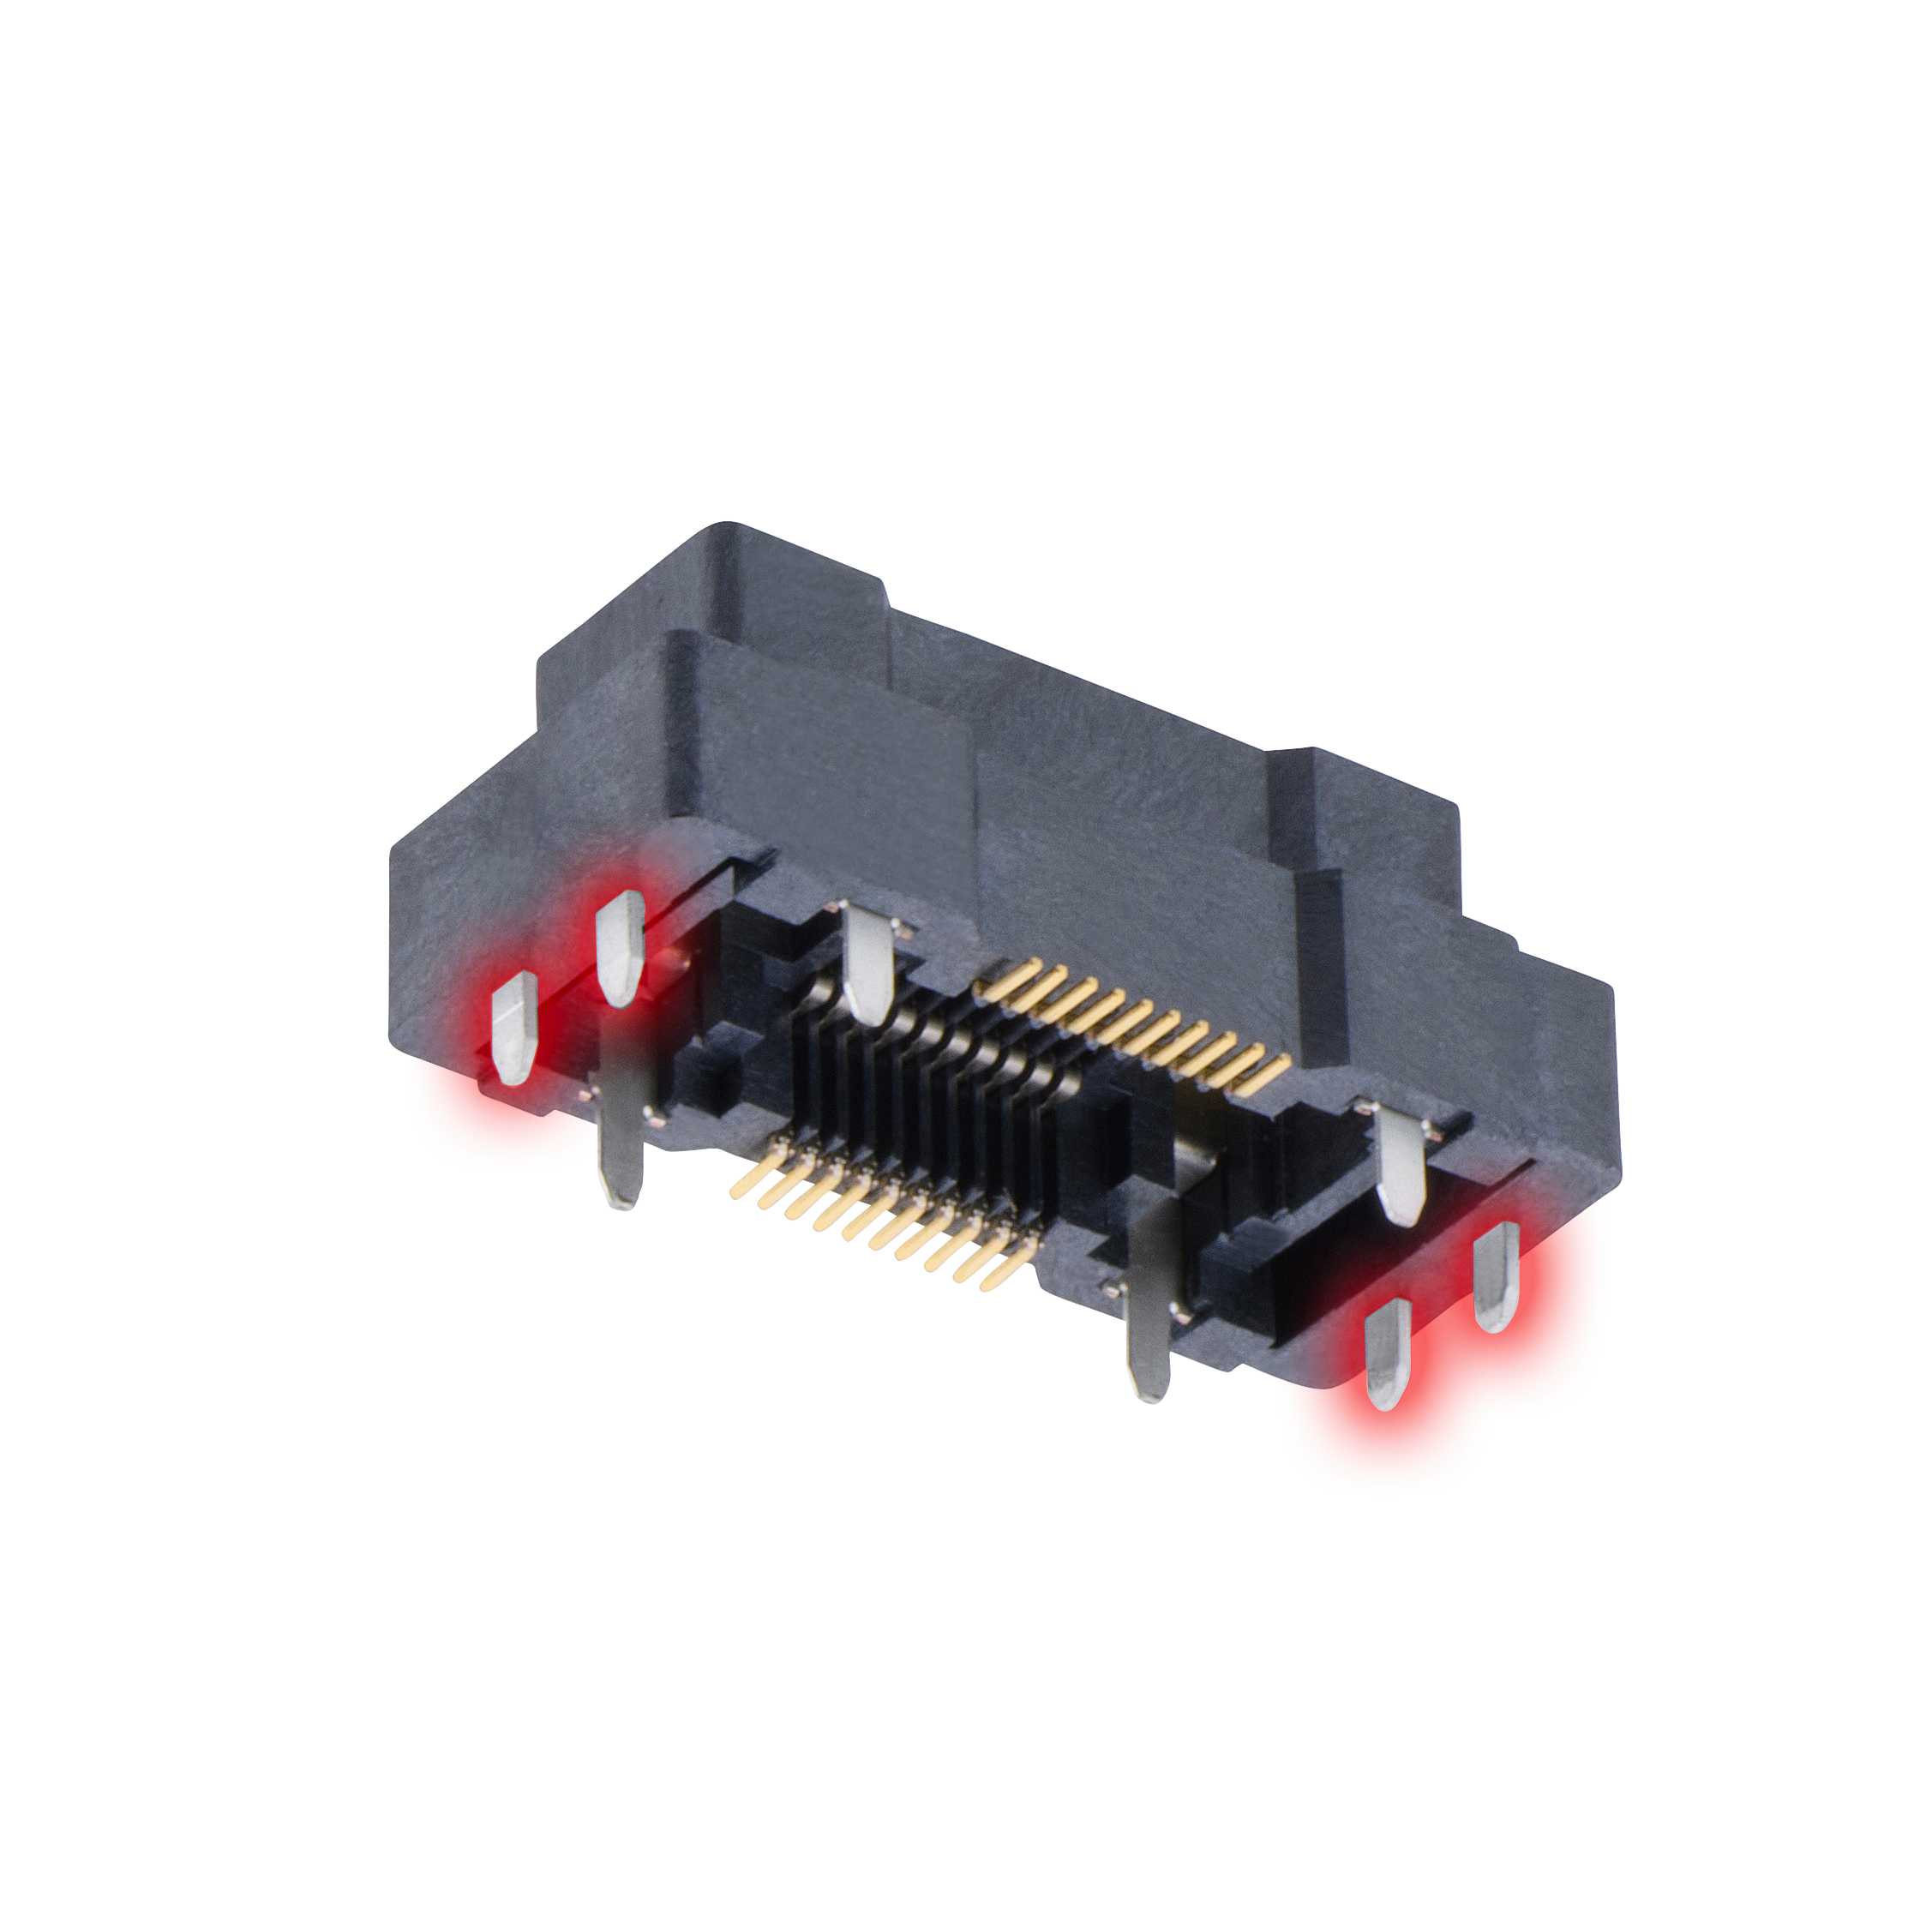
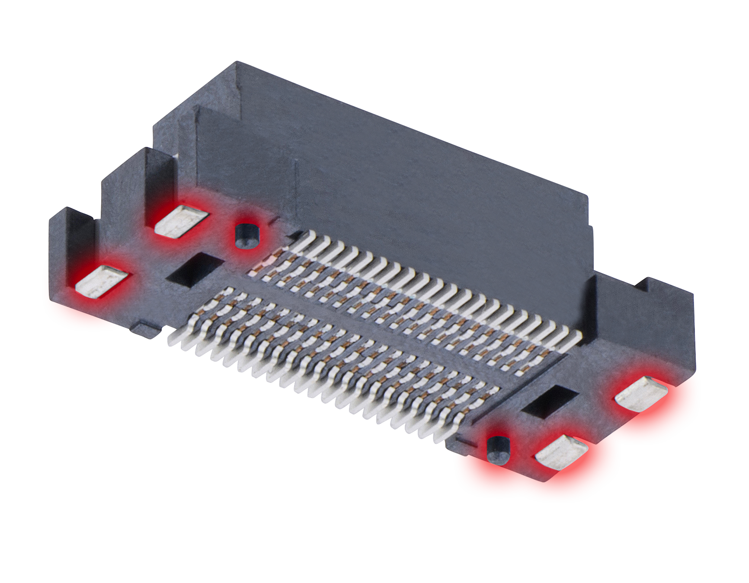
Features – Surface Mount Retention Tabs and Pegs
To assist with correct board placement, all signal-only connectors feature location pegs or posts to inhibit movement during the solder process. To improve surface mount retention to the PCB, retention tabs are located on either end of the connectors which provide additional solder strength.
Connectors including power pins have throughboard solderable posts for both location and additional solder strength.

Slide 9
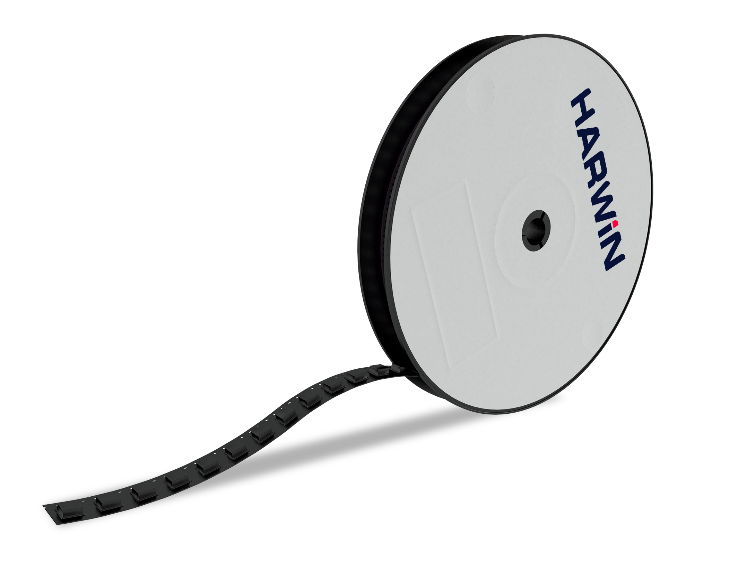
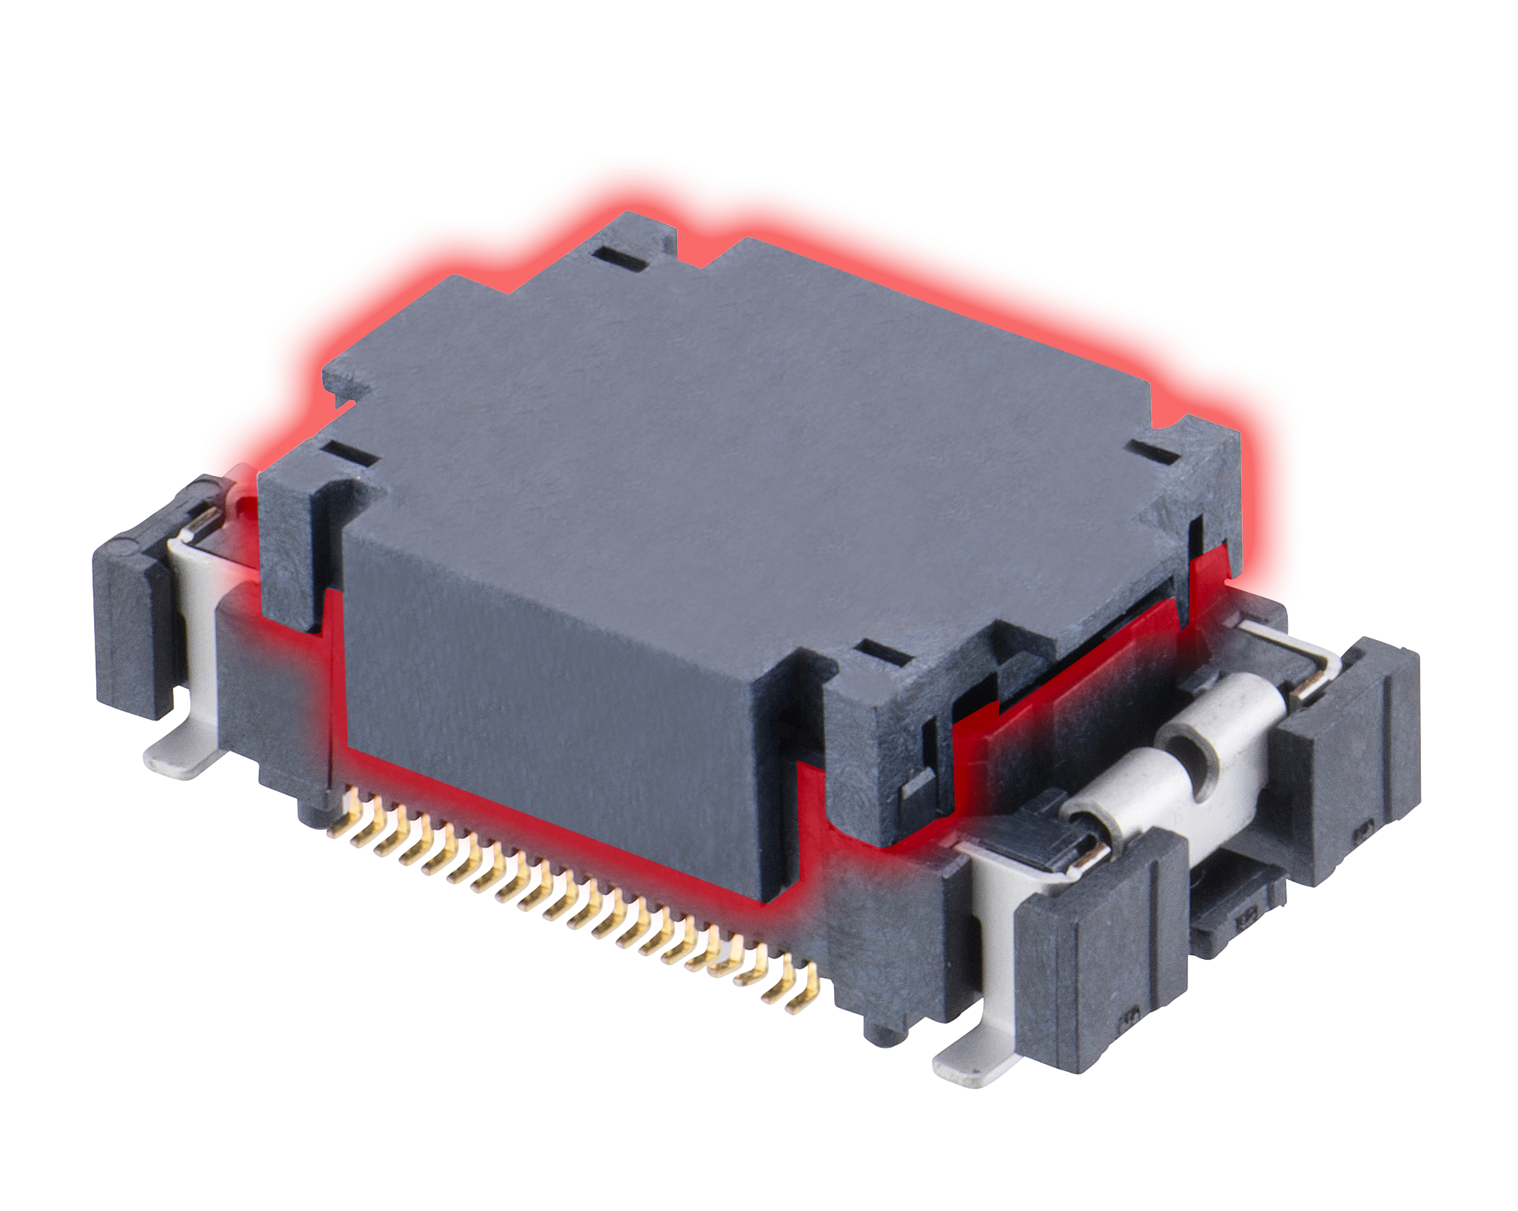
Ready for auto-placement
All Male and Female connectors are available in Tape and Reel packaging options, ready to facilitate automated assembly processes to the PCB. All signal terminations are SMT, all power terminations are throughboard.
The vertical connectors are fitted with disposable pick-and-place caps or tape – for the horizontal connectors, there is already a suitable flat surface on the connector itself.

Slide 10
FINE PITCH OPTIONS
F10/F12: 0.50mm
F11: 0.5mm
F20: 0.635mm
F30: 0.80mm
Flecto is available in 3 different pitches, with the smallest pitch also available with power pins:
F10 and F12 series = 0.50mm (.0197”) pitch - all signal, F10 does not mate with F12
F11 series = 0.5mm (.0197”) pitch - signal + power
F20 series = 0.635mm (.025”) pitch
F30 series = 0.80mm (.0315”) pitch

Slide 11
F10 series – 0.5mm pitch: variable heights, all signal
The F10 range has 3 different heights in the female connector, and the male connector incorporates the floating mechanism.
F10-100xxx45R = Female SMT 6.40mm – mating height is 17.90mm nominal – 30 and 100 contact options
F10-101xxx45R = Female SMT 13.40mm – mating height is 24.90mm nominal – 30 and 100 contact options
F10-102xxx45R = Female SMT 18.40mm – mating height is 29.90mm nominal – 30 / 40 / 60 / 80 / 100 / 120 / 140 / 160 contact options
F10-200xxx45R = Male SMT – mating height is dependent on female connector – 30 / 40 / 60 / 80 / 100 / 120 / 140 / 160 contact options

Slide 12
F11 series – 0.5mm pitch: variable heights, signal + power
Female connectors are supplied in vertical or horizontal format. The 4 power contacts are located around the 2 mating posts on the male connector, internal contacts on the female. The male connectors have 2 different heights and incorporate the floating mechanism. Signal contact counts options are 20 / 40 / 60 / 80 / 100 / 120.
Female connectors:
F11-100xxx42R = Vertical
F11-111xxx42R = Horizontal (90°)
Male connectors:
F11-200xxx42R = 13.20mm high, 15.00mm nominal mating height with F11-100
F11-201xxx42R = 18.20mm high, 20.00mm nominal mating height with F11-100

Slide 13
F12 series – 0.5mm pitch: compact mating height
The F12 mating connectors are suitable for a smaller board-to-board height requirement with a nominal mated height of 7.65mm. Available with 40 contacts.
F12-10004042R = Female SMT
F12-20004045R = Male SMT

Slide 14
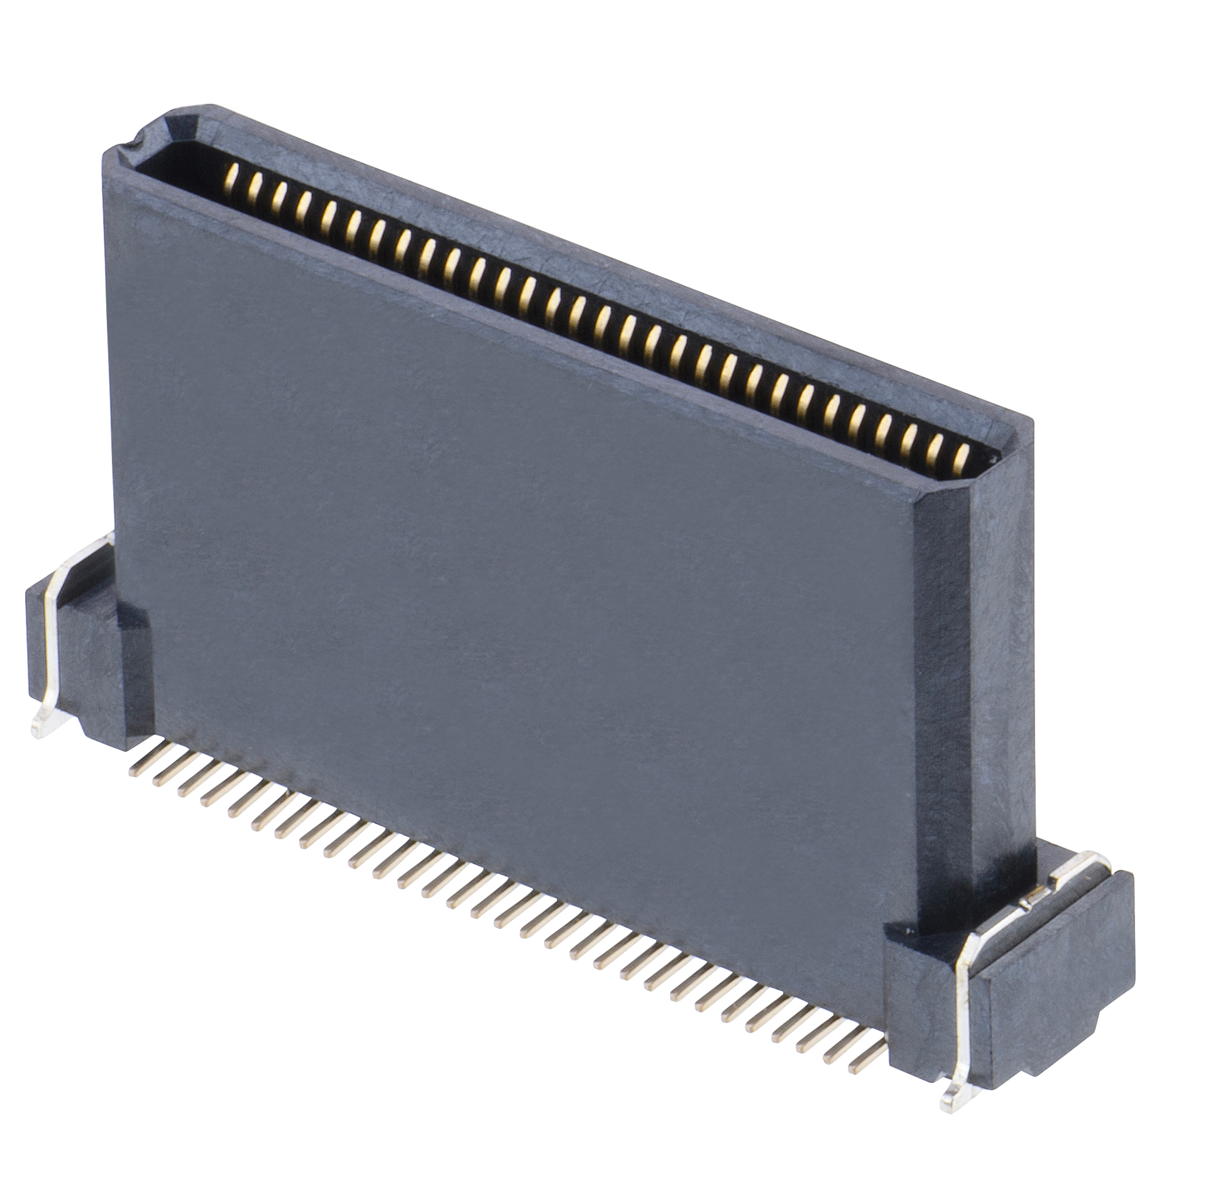
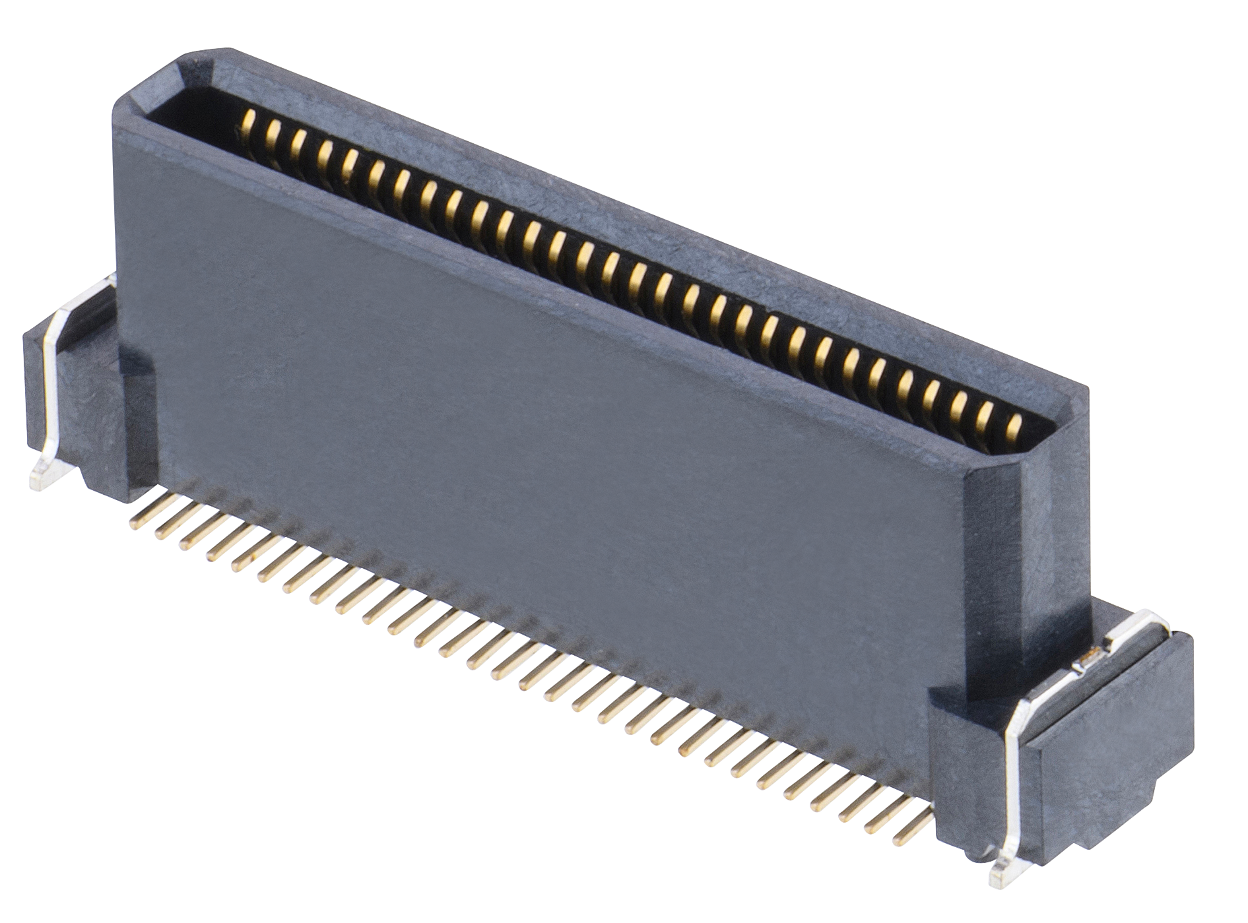
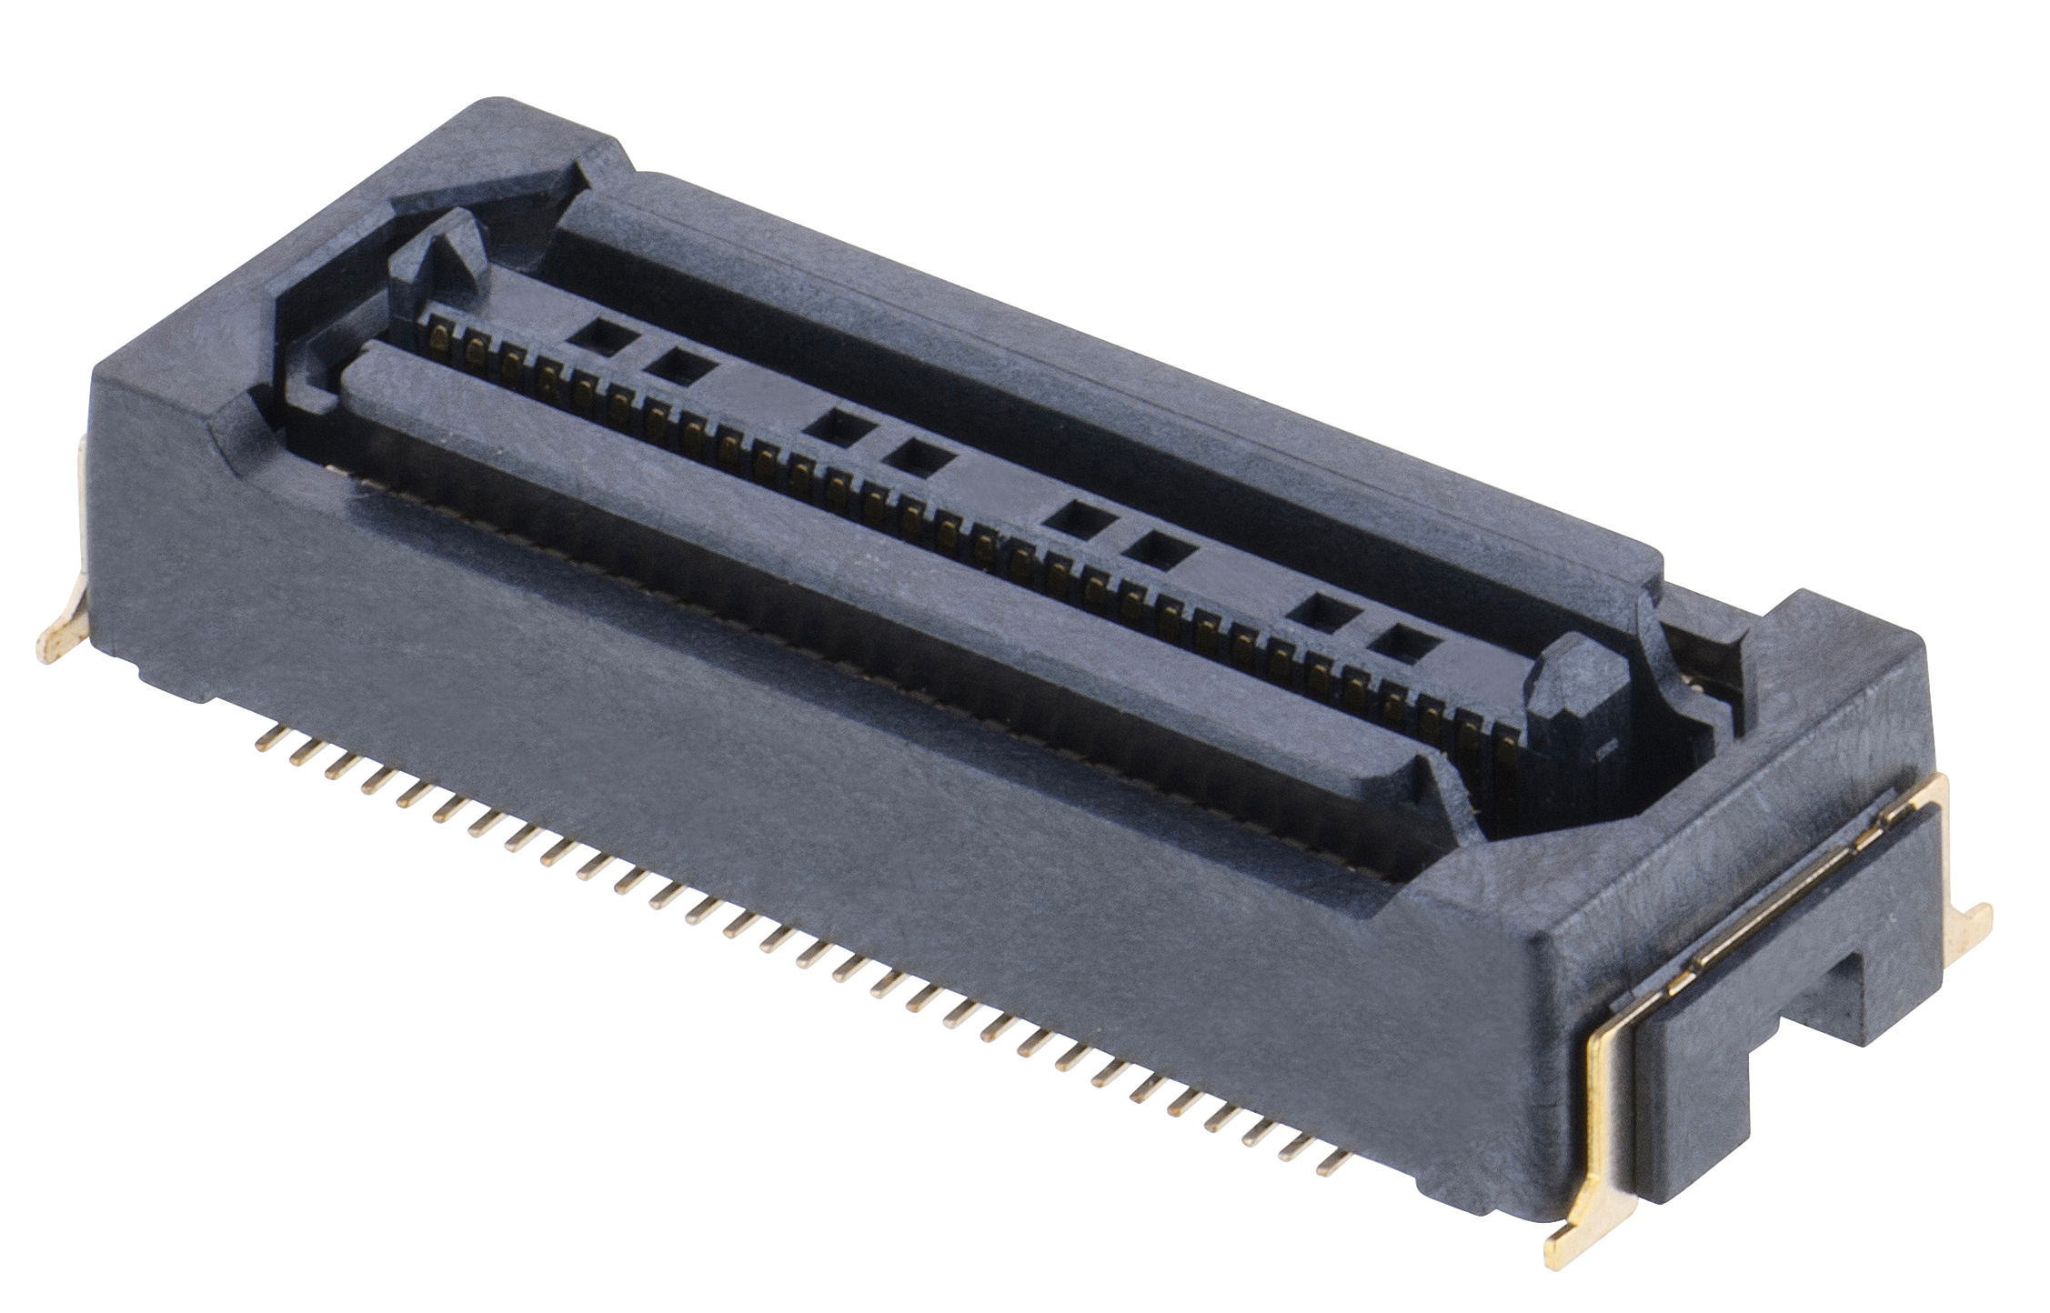
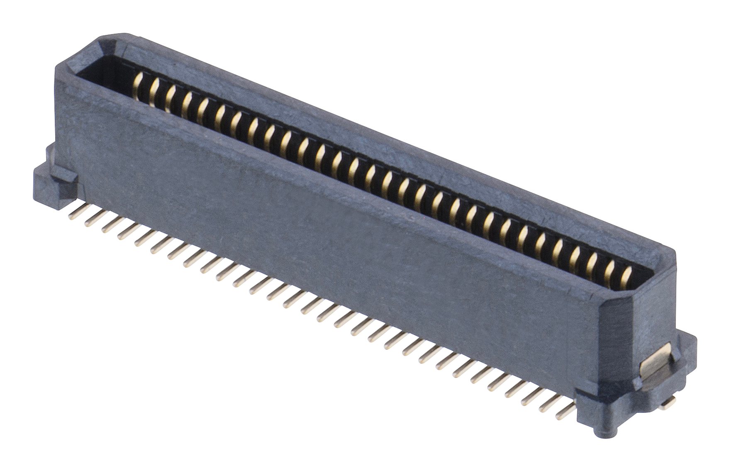
F20 series – 0.635mm pitch: variable heights, all signal
The F20 range also has 3 different heights in the female connector, and the male connector incorporates the floating mechanism. 60 and 80 pin counts are available.
F20-100xxx45R = Female SMT 4.28mm – mating height is 5.98mm nominal
F20-101xxx45R = Female SMT 8.18mm – mating height is 9.88mm nominal
F20-102xxx45R = Female SMT 13.18mm – mating height is 14.88mm nominal
F20-200xxx45R = Male SMT – mating height is dependent on female connector

Slide 15
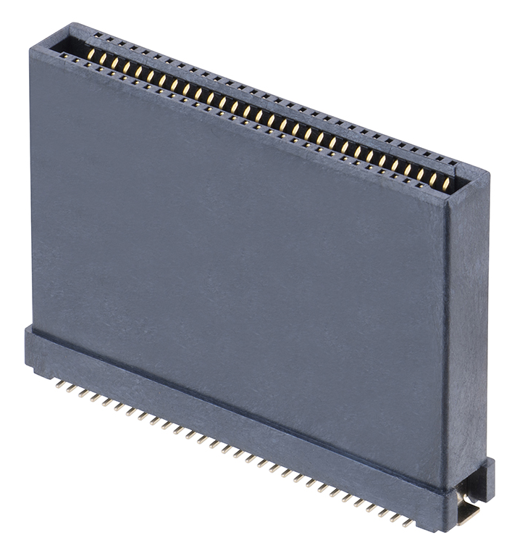
F30 series – 0.8mm pitch: variable heights, all signal
Nominal mating heights |  | MALE
 |  | F30-200 | F30-201
FEMALE | F30-100 | 8.00mm | 11.75mm
 | F30-101 | 9.00mm | 12.75mm
 | F30-102 | 20.95mm | 24.70mm
The F30 range has 3 different heights in the female connector, and 2 different heights in the male connector, which also incorporates the floating mechanism.
Female connectors:
F30-100xxx45R = 6.80mm high, 60 or 80 contacts
F30-101xxx45R = 7.80mm high, 60 or 80 contacts
F30-102xxx45R = 19.75mm high, 60 / 80 / 100 contacts
Male connectors:
F30-200xxx45R = 4.70mm high, 60 / 80 / 100 contacts
F30-201xxx45R = 8.45mm high, 60 or 80 contacts

Slide 16
Electrical Specifications
Current Rating | Signal Contacts = 0.5A per contact (0.4A for F10 series) Power Contacts = 3A per contact
Contact Resistance | 100mΩ max
Insulation Resistance | 100MΩ min
View the C057XX Component Specification for more detail.

Slide 17
Mechanical & Environmental Specifications
X, Y and Z Axis movement / misalignment | Z axis = ±0.5mm (all ranges) X / Y axes for F10, F12, F30-200 = ±0.5mm X / Y axes for F20 = ±0.7mm X / Y axes for F30-201 = ±0.8mm
Temperature Range | Signal + Power (F11 series) = -55°C to +105°C Signal Only = -40°C to +105°C
Durability | 100 mating cycle operations min (F10, F11, F20, F30) 30 mating cycle operations min (F12)
The complete product range is manufactured using LCP housings and copper alloy contacts.
Maximum recommended solder temperature (soldering heat resistance) is 260°C for 10 seconds.

Slide 18
Legislation – Environmentally friendly material
The materials used in the Flecto connectors do not contain any Lead, Brominated Flame Retardants, Red Phosphor (PFOS/PFOA) or Antimony; they are Halogen-free.
They are fully RoHS Compatible and contain no REACH SVHCs.

Slide 19
Markets

Slide 20
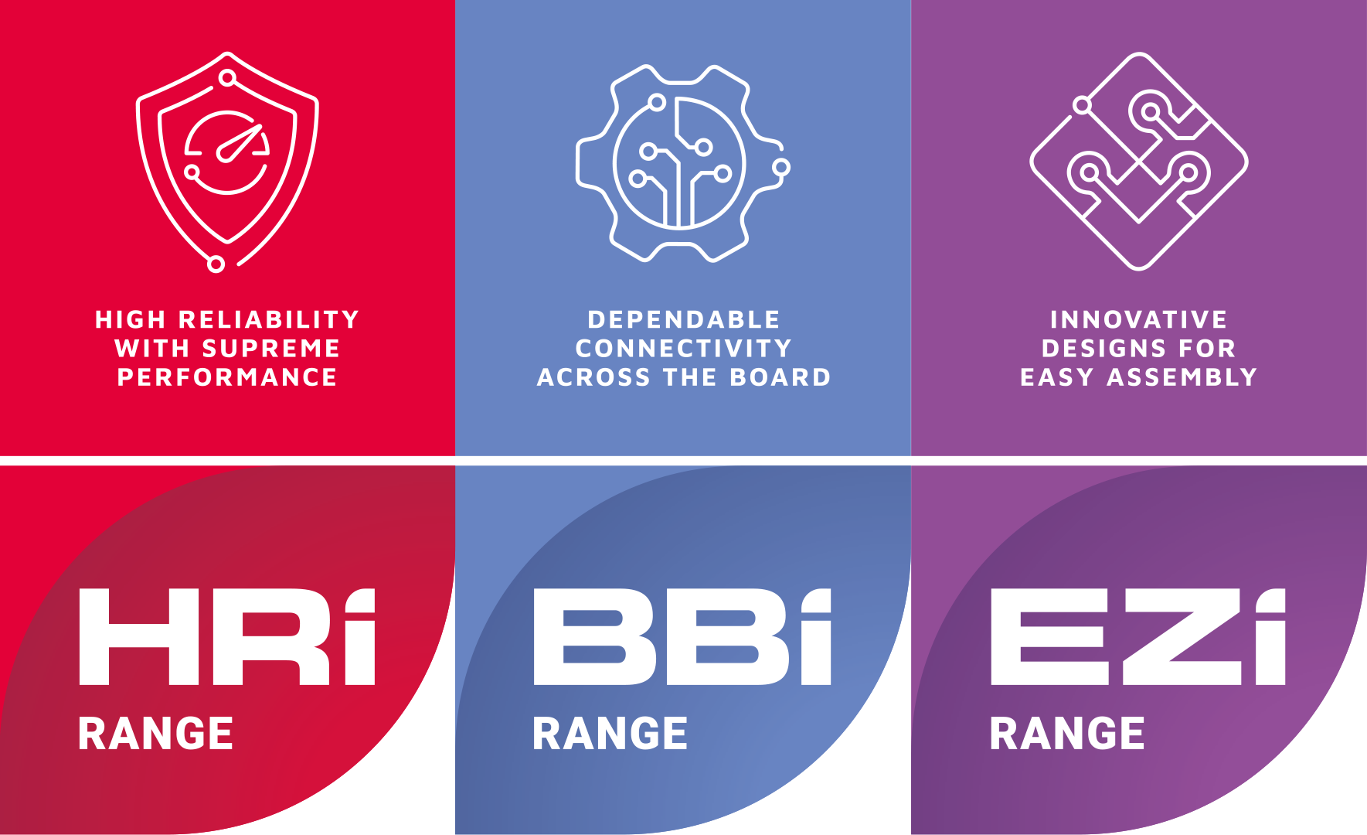
LEARN MORE ABOUT OUR OTHER RANGES
Find out more about our full range of inter-connection solutions at www.harwin.com
FLECTO | CP065/27062025

Slide 21
GET HELP FROM A HARWIN EXPERT
Our experts are specialists in their field with many years of experience in their respective roles and industries.
Find an expert that can help you with your enquiry.
Click Here >>
CAD Models and Evaluation Samples also available at www.harwin.com
FLECTO | CP065/27062025

Slide 22
Contact Us

